Slide 1


Integrated Asset Management System (IAMS)
Developed by Center for Modernizing Government Initiative (CMGI)
General Administration and Public Grievance (AR) Department
Government of Odisha
1
1
1
Notes:
1

Slide 2
INTRODUCTION
Integrated Asset Management System (IAMS) is developed in house to ensure smooth management of residential land conversion within Bhubaneswar Municipal Corporation area from "leasehold” to "freehold“ initially and later NOC and Mutation added to minimize processing time and bring transparency in the process followed by the General Administration Department through use of Information and Communication Technology.
IAMS is an integrated land database and digitized files in order to refer the relevant file and act upon it for conversion into freehold status and tracking of application at different stages by the applicant as well as authority.
.

Slide 3
KEY FEATURES
Online application for conversion , Mutation and NOC for GA residential lease plots.
Receipt of acknowledgement through SMS
Digitalized the land records for smooth communication
Deliver the service to the citizen within the ORTPSA notified time frame.
Intimation for deposition of conversion fees through SMS
Online tracking of application

Slide 4
SERVICES UNDER IAMS
Conversion – Conversion of GA residential lease plots within Bhubaneswar Municipal Corporation area from "leasehold“ to "freehold“. All payments like: application fees, conversion fees, Differential premium fees, consent fees collected through gaestate portal using ifms payment gateway and all communication between applicant and department are done through this portal.
Mutation - In the event of demise of the lessee, the legal heirs /successors-in-interest can apply online for mutation of lease hold land through the gaestate.in portal of the Department. A copy of the order allowing mutation is communicated to the Tahasildar to effect necessary changes in the Records of Rights.
NOC – If any lessee wants to mortgage the lease plot then he/she has to take permission(NOC), No Objection Certificate from GA Department through gaestate portal only.
.

Slide 5

PROCESS FLOW
Revenue supervisor/Assistant Director (Survey & Enforcement) validates the RI’s observation and payment details and sends to ASO/SO. ASO/SO gives his/her views and send it to LO/ALO. Then ALO/LO gives his/her views and forward to Director Estate.
.
ASO verify all documents and payment details and forward to RI for physical land verifications. After Verification RI fill up his observation and also calculate the Bench Mark Valuation and Conversion fees according to the land status and forward to Revenue supervisor/Assistant Director (Survey & Enforcement).
4
3
5
After Checking Director Estate gives his/her views and forwarded to GA & PG Secretary for final approval/Rejection/Returned to Director Estate. After approval the application come to ALO/LO for upload of ink signed conversion order. ALO/LO upload the conversion order, then payment option activated at the applicant end.
Facilitation center admin receives the original documents and give a acknowledgment to applicant then verify documents if ok forward tod to ASO.
Applicant can now deposit the conversion fees through IFMS to make the land to freehold. Rest process of conversion are done manually.
2
6
Registration
1

Slide 6
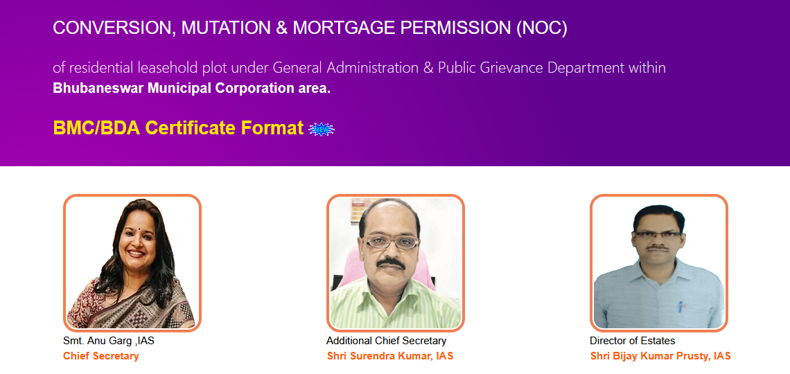
SCREENSHOT HOME PAGE
.

Slide 7
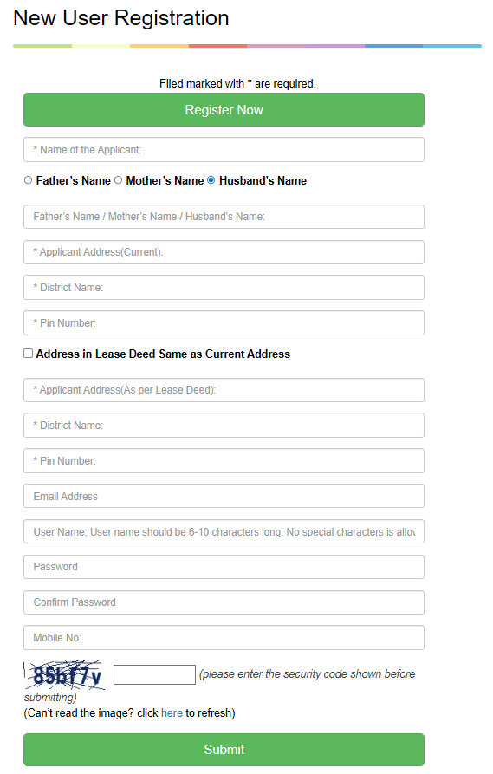
SCREENSHOT REGISTRATION PAGE FOR ( CONVERSION)
.

Slide 8
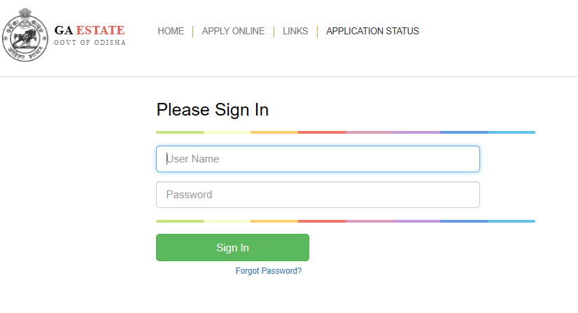
SCREENSHOT FOR LOG IN PAGE ( CONVERSION, MUTATION & NOC)
.

Slide 9
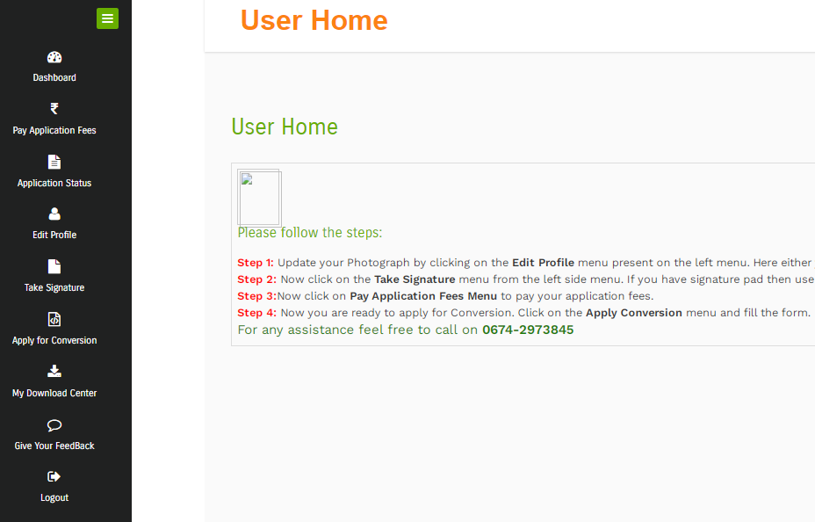
SCREENSHOT FOR USER HOME PAGE ( CONVERSION)
.

Slide 10

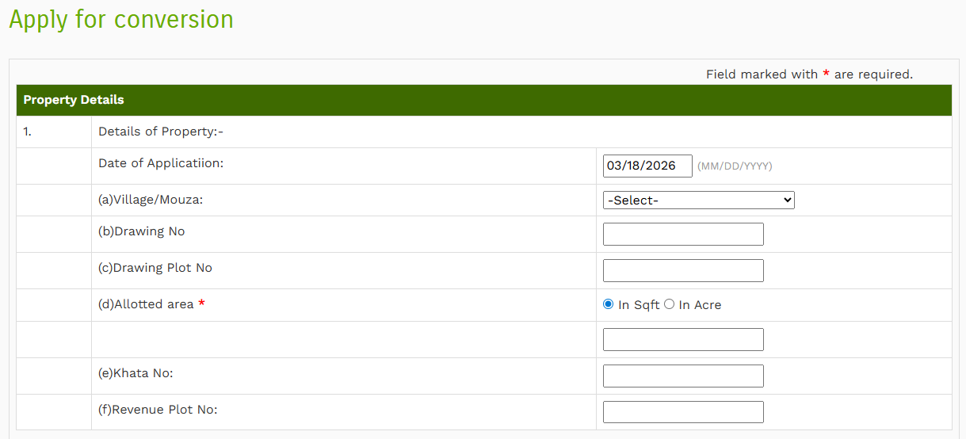

Slide 11
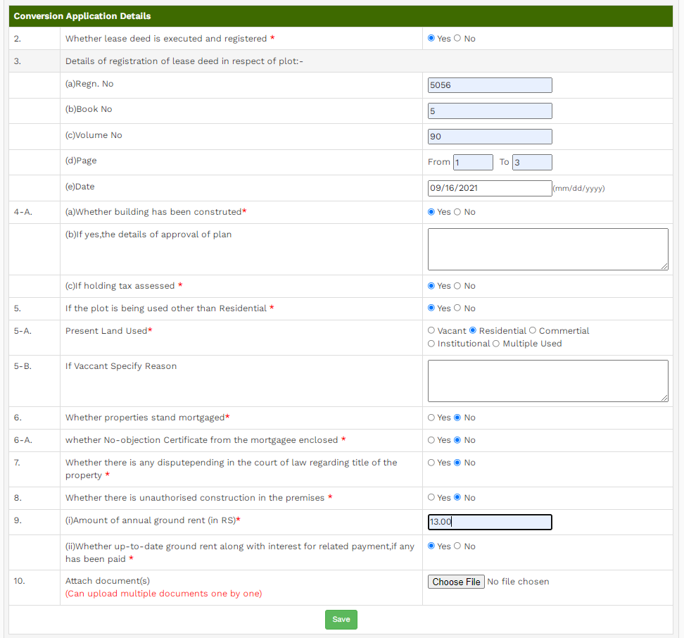
CONVERSION APPLICATION FORM
.

Slide 12
FUNCTION OF FACILITATION CENTRE
A Facilitation Centre is set up in the Estate Court Building near Central Record Room, Secretariat, Bhubaneswar so as to facilitate the applicant to apply online for conversion of residential land within Bhubaneswar Municipal Corporation area from "leasehold" status to "freehold" status.
The applicant has to come to the Facilitation Centre with all relevant papers and documents required for conversion of leasehold land.
The Facilitation Centre operates in office hours of all working days.
After filing of application, the applicant will get a unique acknowledgement number. Also if he/she has provided his/her mobile number during filing of application, then a SMS alert will be communicated indicating his/her acknowledgement number, user name and password for future reference.
The Facilitation Center has the facility of web Camera to capture the live photo of the applicant which will be placed in the space of photograph of the application form.
.

Slide 13
FUNCTION OF FACILITATION CENTRE
The Facilitation Centre has the facility to capture signature of the applicant through the digital signature pad and the same will be put in the space for signature in the application form.
The documents and relevant papers brought by the applicant can be scanned through the high resolution scanner at the Facilitation Centre and can be attached with the application.
The applicant can get the printed copy of the acknowledgement at the Facilitation Centre.
Further, the applicant can come to the Facilitation Centre during office hours of any working days for checking of status of the application.
.

Slide 14
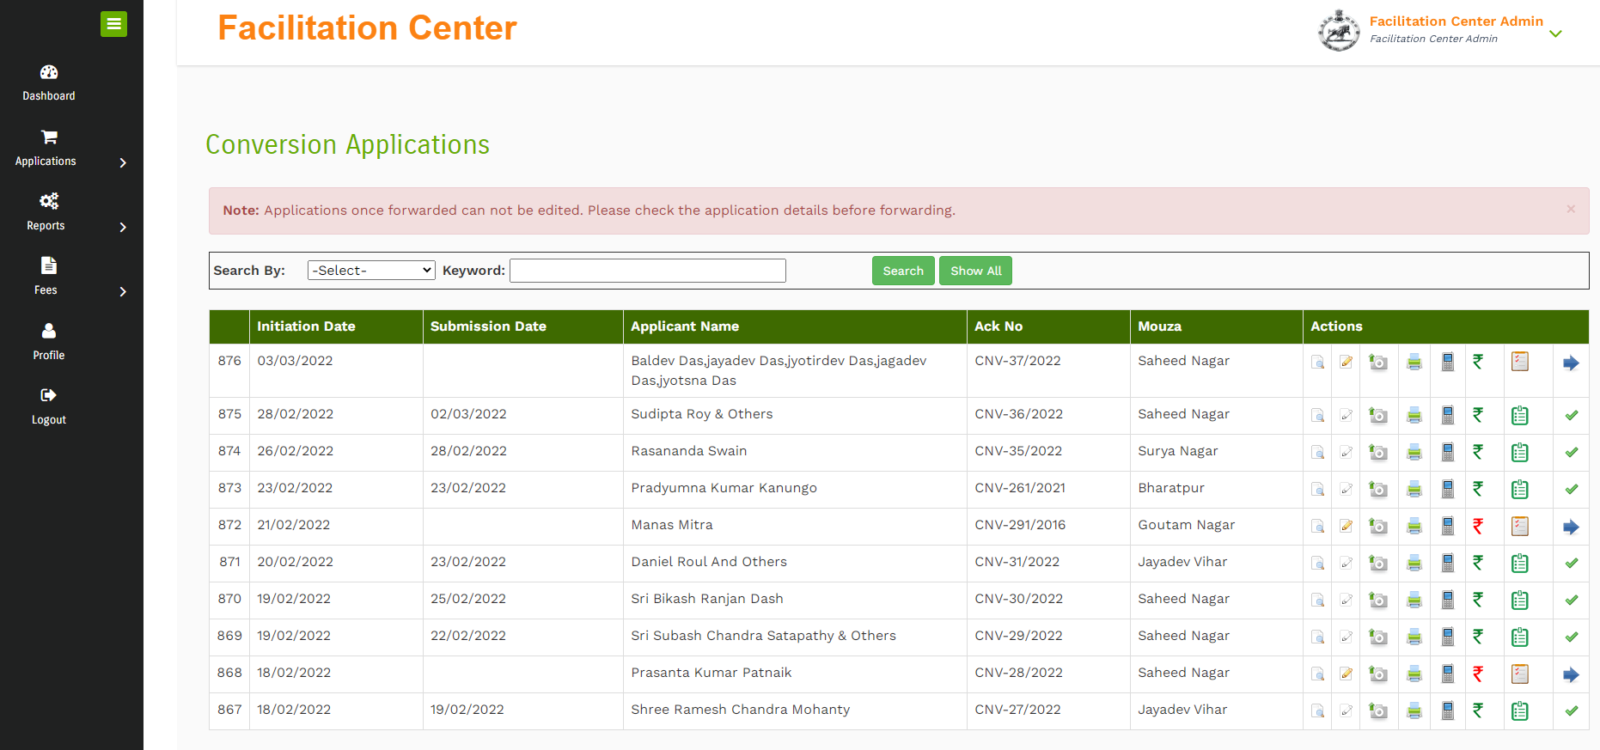
FACILITATION CENTRE DASHBOARD ( CONVERSION)
.

Slide 15
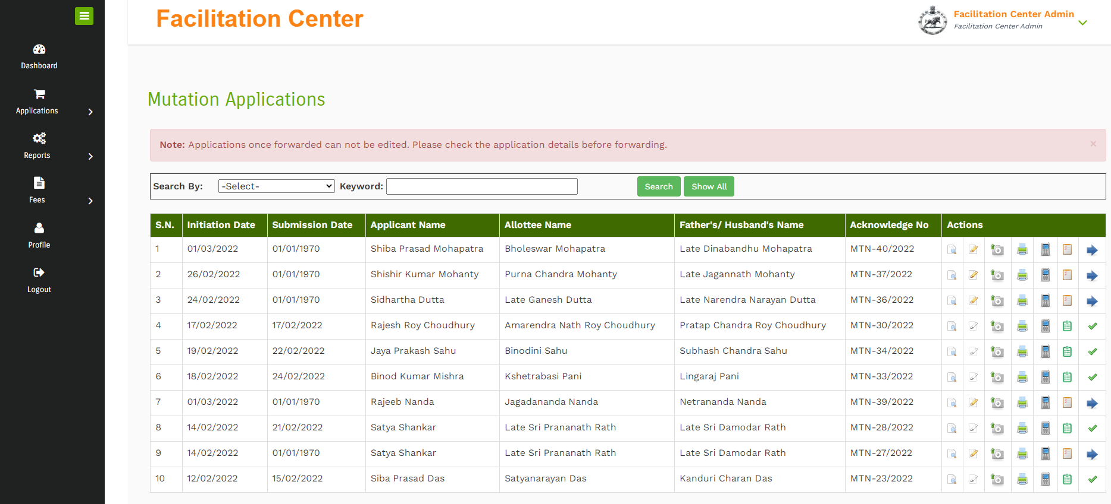
FACILITATION CENTRE DASHBOARD ( MUTATION)
.

Slide 16
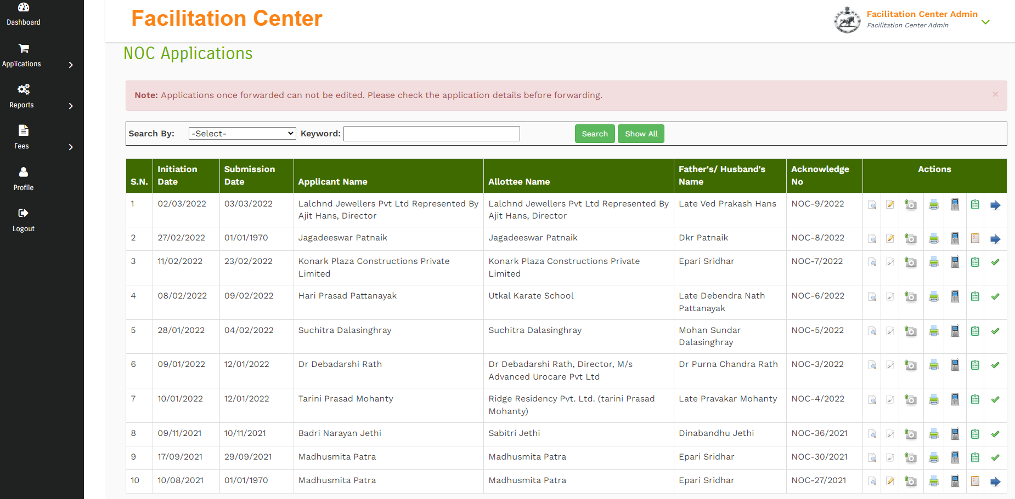
FACILITATION CENTRE DASHBOARD ( NOC)
.

Slide 17
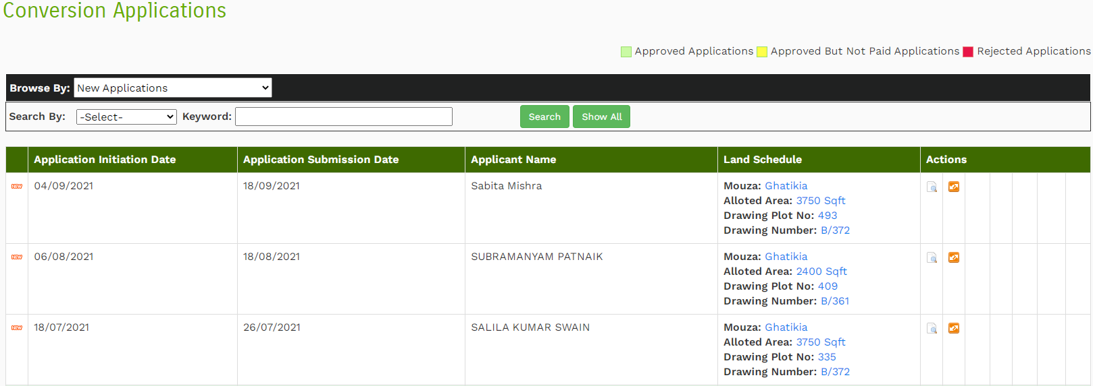
SECTION OFFICER DASHBOARD
.

Slide 18
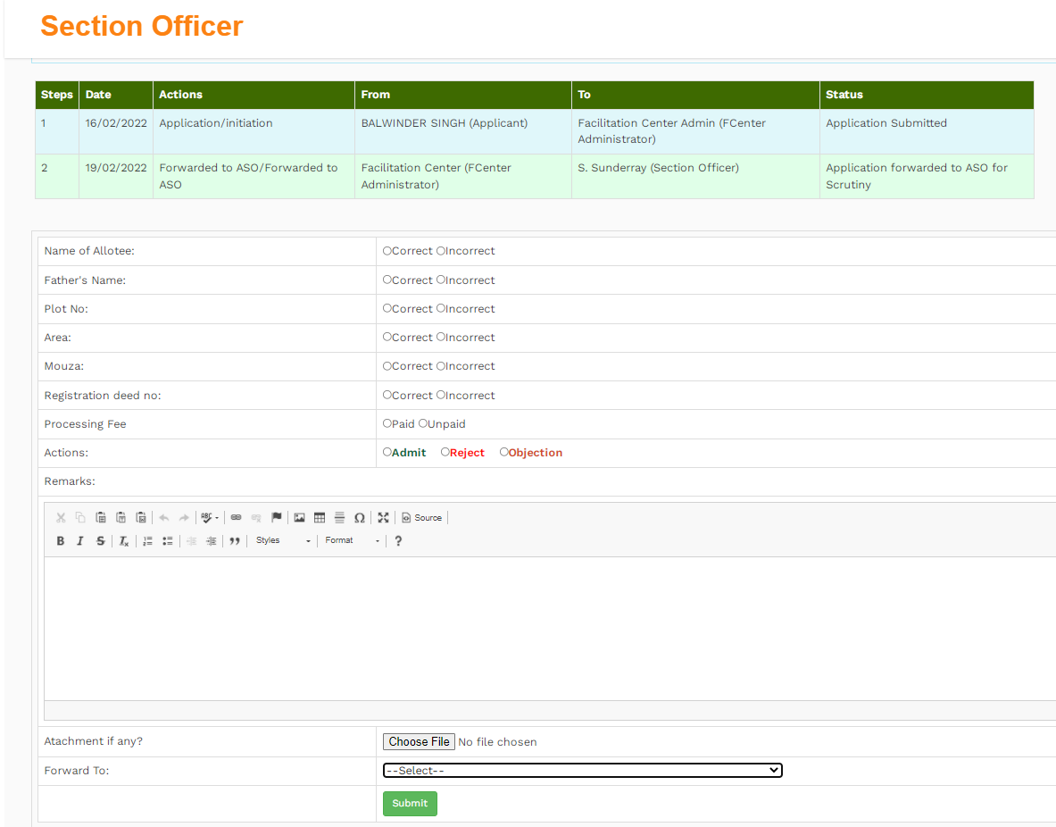
SECTION OFFICER SCRUTINY
.

Slide 19
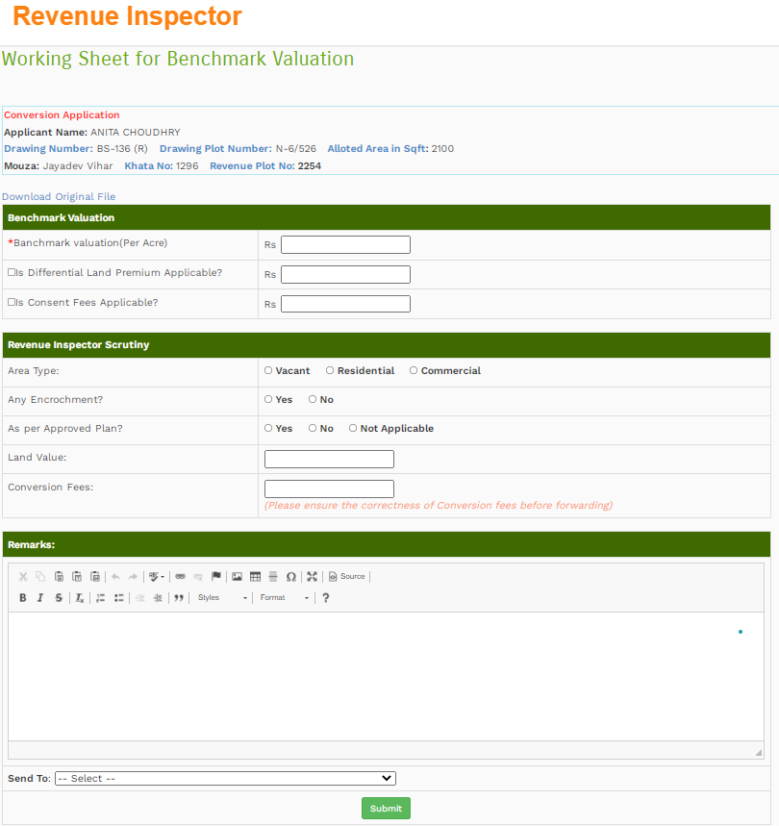
REVENUE OFFICER SCRUTINY
.

Slide 20
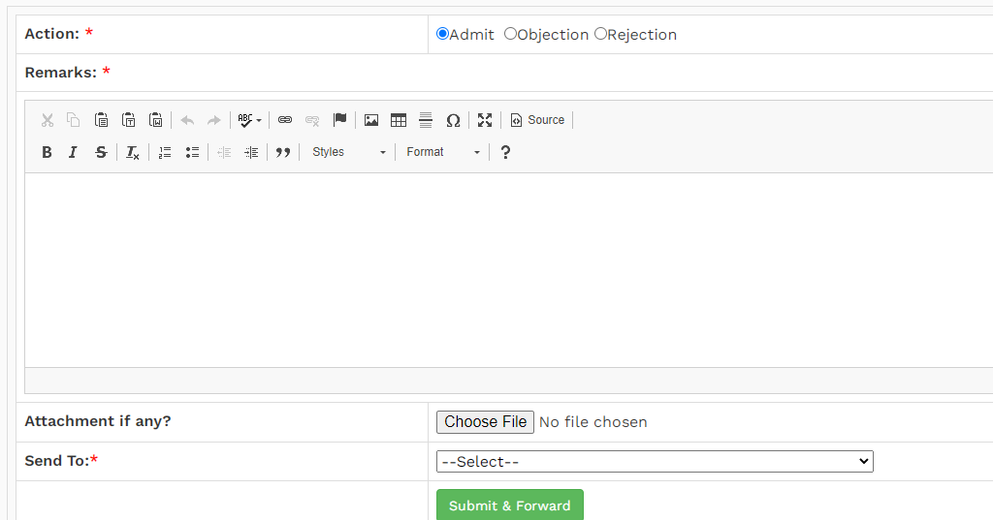
ALO VERIFICATION PAGE
.

Slide 21
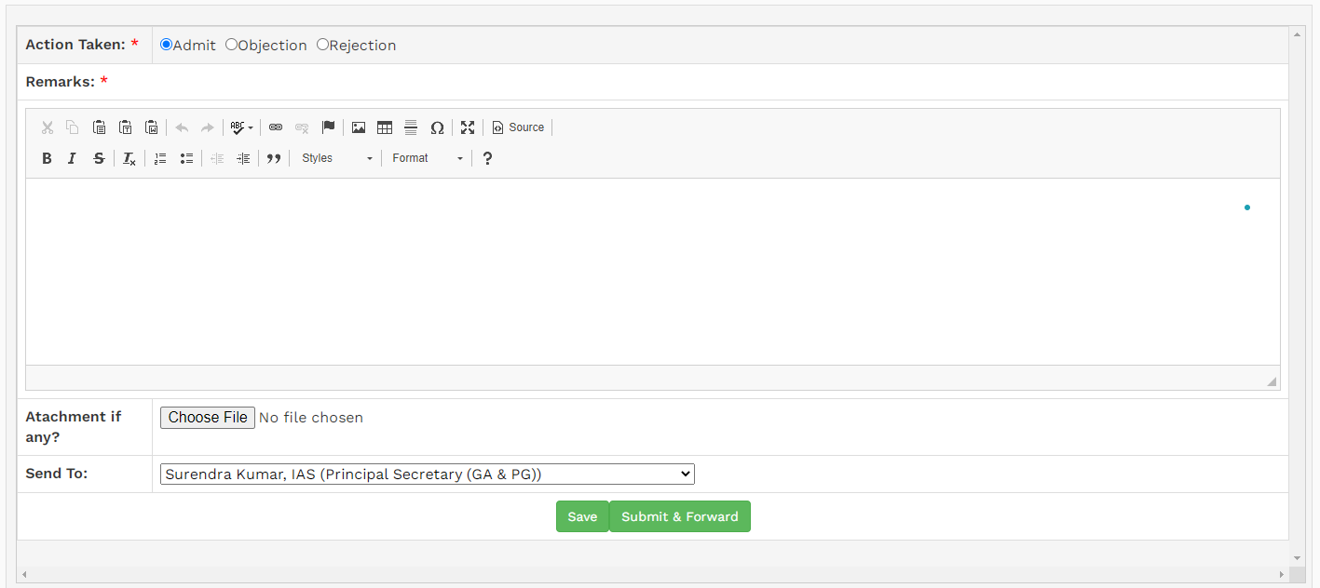
DIRECTOR ESTATE VERIFICATION PAGE
.

Slide 22
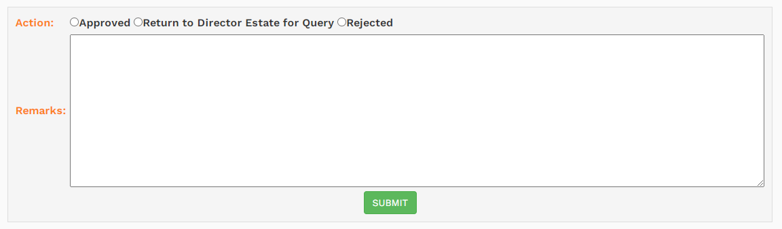
SECRETARY APPROVAL PAGE
.

Slide 23
PROCEDURE FOR SUBMISSION OF APPLICATION FOR CONVERSION
Where the applications are submitted with all required papers with fees, and complete in all respects, permission will be accorded in the site www.gaestate.in and the applicant/s shall be intimated regarding permission of his/her/their conversion application through unique Registration No that was allocated during online application besides dispatch of hardcopy.
The lessee shall take out the printouts of the conversion application form from www.gaodisha.gov.in/www.gaestate.in after filling up the same with details of lease hold plots and lessee duly signed by applicant(s).
.
1
5
Indemnity Bond executed before Notary and Affidavit executed before Executive Magistrate in the prescribed format of the G.A. Department available in www.gaodisha.gov.in/www.gaestate.in is compulsory for conversion of residential plots.
.
2
6
The lessee/applicant shall prepare Conveyance Deed in stamp papers in consultation with the District Sub- Registrar, Bhubaneswar/ Sub-Registrar, Khandagiri, Bhubaneswar and submit the same in G.A. Department for approval within 30(thirty) days.
.
FOR CONVERSION
The applicant/lessee shall submit the conversion application along with all requisite documents in the facilitation centre of G.A. Department in the premises of Estate Court.
.
3
The lessee/applicant shall bear the stamp duty and registration fees and register the conveyance deed in consultation with the District Sub- Registrar, Bhubaneswar/Sub-Registrar, Khandagiri, Bhubaneswar.
7
If the application is incomplete in any respect or fees have not been deposited through online treasury deposit, the same shall not be accepted in the facilitation centre.
.
4

Slide 24
DOCUMENTS TO BE SUBMITTED ALONG WITH FREEHOLD APPLICATION
The lessee shall be required to submit following documents alongwith the original freehold application. The Online Printed application duly signed by applicant(s).
E-Receipt of Conversion Application Fees.
Self Attested photocopy of the original lease deed/tripartite deed.
Self Attested copy of the up to date rent receipt.
An affidavit to be sworn in by the lessee before the Executive Magistrate to the effect that he/she has constructed the building and used the same for the purpose for which the land was allotted or deviation (if any) has been made.
Self Attested copy of the no objection certificate from the mortgagee in case the plot is mortgaged. Front side Self Attested Photograph of the applicant / applicants (All Mutates)
Indemnity bond in prescribed Form from Notary / Executive Magistrate.
Self Attested copy of up-to-date Holding Tax receipt (if assessed).
Self Attested copy of Identity Proof of the applicant(s).
Three Specimen Signatures of application (s)in the prescribed form.
Self Attested Photocopy of mutation copy.
In appropriate cases there may be spot verification.
.

Slide 25
PROCEDURE FOR SUBMISSION OF APPLICATION FOR MUTATION
Self Attested Copy of up to date holding tax receipt. Self Attested Copy of RoR.Self Attested Copy of E.C (Encumbrance Certificate). Self Attested Copy of Relinquishment deed if any.
The Online Printed application duly signed by applicant(s).The legal heir certificate of lessee & the legal heir certificate of legal heir/s of lessee if any. Self Attested Copy of original lease deed.Self Attested Copy of up to date rent receipt.
2
4
1
3
5
The lessee shall take out the printouts of the mutation application form from www.gaodisha.gov.in/www.gaestate.in after filling up the same with details of lease hold plots and lessee duly signed by applicant(s).
Self Attested Copy of WILL executed by lessee and Probate their on from competent Authority if any. During the process of disposal of mutation application the legal heirs of the lessee shall have to visit the land section with all their original documents for verification on intimation.
Self Attested Copy of ID Proof of all legal heirs. The death certificate of lessee & the death certificate of legal heir/s of lessee if any.

Slide 26
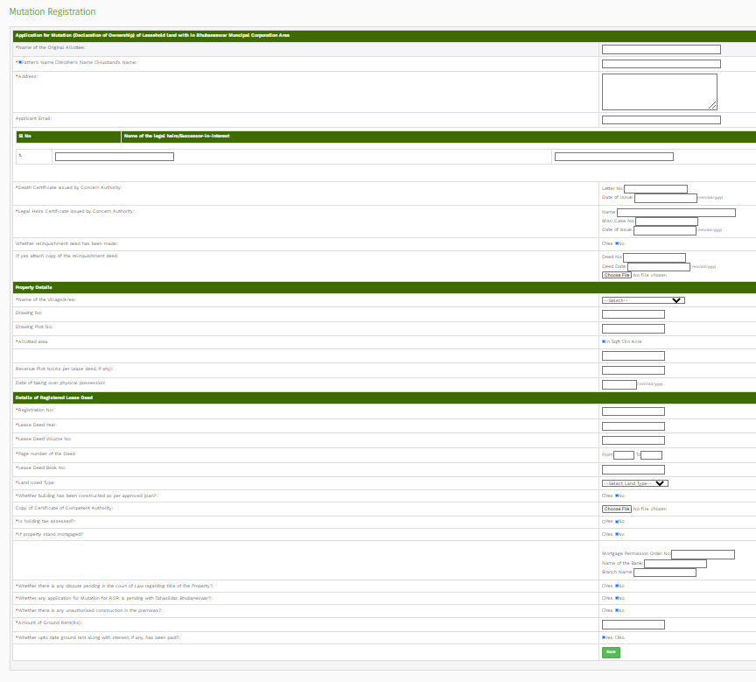
MUTATION APPLICATION FORM
.

Slide 27
PROCEDURE FOR SUBMISSION OF APPLICATION FOR MORTGAGE PERMISSION ( NOC)
Self Attested Copy of No Objection Certificate issued by the financial institution/Mortgager if any.Self Attested Copy of E.C (Encumbrance Certificate). Self Attested Copy of up to date rent receipt.
.
Self Attested Copy of up to date holding tax receipt. Self Attested Copy of original lease deed.
3
4
The Online Printed application duly signed by applicant(s). Self Attested Copy of approved building plan by the Competent Authority. Self Attested Copy of project report & re-payment Schedule in case of Commercial leases.
2
5
The consent letter of the financial institution mentioning the loan component.
The lessee shall take out the printouts of the NOC application form from www.gaodisha.gov.in/www.gaestate.in after filling up the same with details of lease hold plots and lessee duly signed by applicant(s).
1
6
Self Attested Copy of ID Proof. If the authority so pleases, the lease plot shall be subject to spot verification by the R.I of G.A. Department.

Slide 28
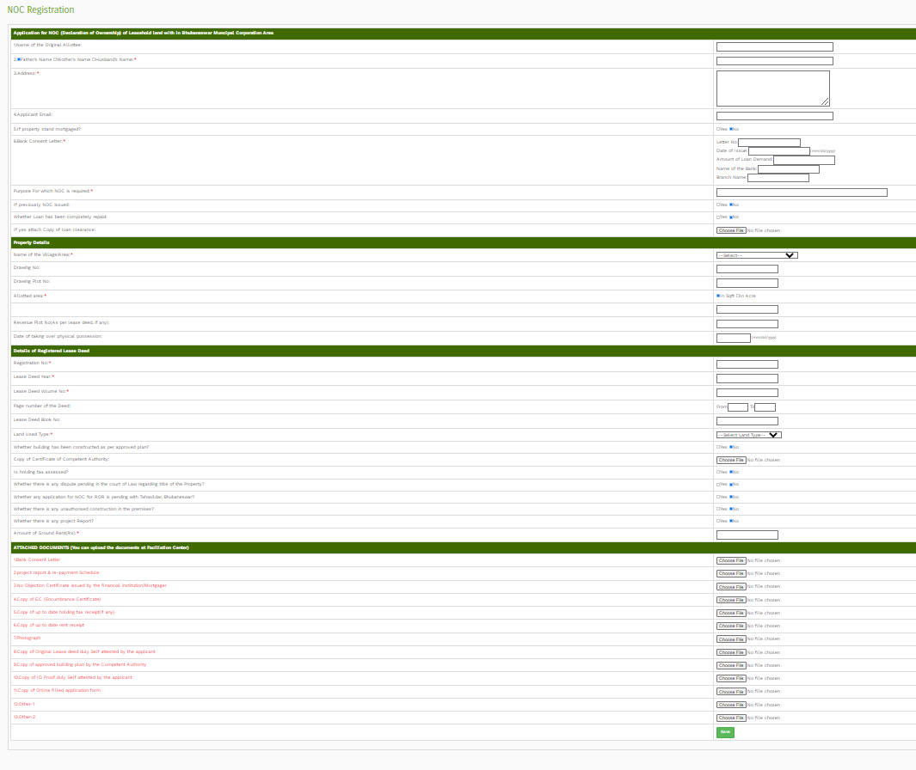
NOC APPLICATION FORM
.

Slide 29
Thank You!
29

